Slide 1
https://github.com/Prithiv-0/Fullstack-project
23CSE461 – FULL STACK FRAMEWORKS
SMART CITY COMMAND & INTELLIGENCE PLATFORM​

Slide 2
Roll No. | Name | Email (official) | Email (personal) | Mobile No. | Github URL
CB.SC.U4CSE23759 | Balaji arunachalamn | cb.sc.u4cse23759@cb.students.amrita.edu | Balajiarundevelops@gmail.com | 90800 78322 | https://github.com/arnchlmcodes
CB.SC.U4CSE23241 | Danvanth | cb.sc.u4cse23241@cb.students.amrita.edu | realdanvanth@gmail.com | 9047254353 | https://github.com/realdanvanth
CB.SC.U4CSE23407 | Amal Godwin | cb.sc.u4cse23407@cb.students.amrita.edu | amalgodwin004@gmail.com | 6374484675 | https://github.com/AJgodwin
CB.SC.U4CSE23260 | Prithiv A | cb.sc.u4cse23260@cb.students.amrita.edu | prithivalagirisamy@gmail.com | 9047996002 | https://github.com/Prithiv-0

Slide 3
Abstract
System Architecture: A full-stack smart city platform with an integrated AI intelligence layer.
Data Collection: Automatically gathers information from citizens, social media, traffic systems, and city databases.
Issue Understanding: Identifies what the issue is, where it is located, and how serious it is.
Alerts & Coordination: Sends real-time alerts to responsible government departments and nearby citizens.
City Dashboard: Provides a single live dashboard with maps, alerts, and insights for better decision-making.

Slide 4
About the product
An AI-powered platform designed to monitor city-wide issues continuously.
Acts as a digital city control room for government authorities.
Helps detect, analyze, and manage urban problems in real time.
Automatically connects reported issues to the correct government departments.
Reduces dependency on manual monitoring and phone-based complaints.
Supports continuous city monitoring and faster problem resolution.

Slide 5
About the product (Compared)
Traditional Complaint Systems: Manual reporting with delayed response and no clear tracking.
Traffic Monitoring Systems: Focus only on traffic and ignore other city problems.
Department-Specific Tools: Work independently with no coordination between departments.
Public Alert Systems: Only broadcast messages without understanding issue severity.
Smart City Command Platform: A single, integrated system that detects, prioritizes, and manages all city issues in real time.

Slide 6
Introduction
Urban cities generate massive unstructured data: traffic updates, public grievances, tweets, CCTV signals, sentiment pulses, emergency alerts. However, authorities lack a unified, intelligent system to interpret and operationalize it.
This project proposes a Smart City Command platform that automatically gathers data from citizens, social media, and city systems to detect and locate urban issues.
The platform delivers real-time alerts and a unified dashboard for officials and citizens, enabling faster response and better city management.
This Product addresses
Growing workflow complexity in municipal operations
Requirements for AI-based triage, early warnings, and citizen-friendly governance

Slide 7
Features
Automatic issue detection from social media and citizen reports
Location-aware pothole, traffic, and roadblock identification
AI-based issue severity and priority ranking
Real-time alerts to responsible government departments
Public notifications for nearby citizens and commuters
Unified city monitoring and analytics dashboard
End-to-end issue tracking from report to resolution

Slide 8
Problem Statement
Urban governance systems generate large volumes of data from multiple sources such as traffic management systems, citizen complaints, sensors, and public platforms. However, this data is often fragmented across departments and lacks intelligent processing, leading to delayed responses, inefficient coordination, and limited visibility into city-wide issues.
There is a need for a unified, full-stack platform that can integrate diverse data sources, analyze them intelligently, and provide real-time, actionable insights to support faster decision-making and improved civic service delivery.

Slide 9
Problem Statement
Decision-Making Gap
There is no centralized platform that intelligently analyzes and correlates real-time and historical urban data to support city-level decision-making. Information related to traffic issues, civic complaints, public safety incidents, and infrastructure status is scattered across multiple systems and departments, without contextual analysis or prioritization.
Impact of the Problem
Due to this gap, city authorities often make decisions under time pressure, limited visibility, and incomplete information. This leads to delayed incident response, inefficient resource allocation, poor inter-department coordination, and reduced trust among citizens in urban governance systems.

Slide 10
Target Users
Targeted User | Need for the Product | Expected Outcome
Citizens | No single platform to report issues or receive alerts about nearby disruptions | Easy issue reporting and real-time alerts for safety and travel planning
Government Officials | Overwhelmed by scattered reports and lack of priority visibility | Unified dashboard showing high-priority issues and clear action points
City Administrators | Lack of data-driven insights on city performance | Analytics on response times, issue trends, and department efficiency

Slide 11
User & Requirement Analysis
Where exactly is the city issue located?
What type of issue is it (pothole, traffic, roadblock, accident)?
How serious is the issue and who is affected?
Which government department should handle it?
How quickly does the issue need to be resolved?
Which citizens need to be informed about this issue?

Slide 12
Usage and Social Relevance
Usage: The platform is used by city administrators, municipal departments, and field officers to monitor incidents, analyze urban trends, and coordinate responses through a centralized dashboard. Citizens can report issues and track resolution status, enabling efficient two-way interaction with city authorities.
Social Relevance: The system improves urban quality of life by enabling faster response to civic issues, promoting transparency in governance, and supporting data-driven decision-making. By leveraging AI-assisted insights, the platform helps reduce service delays, optimize resource allocation, and build trust between citizens and public institutions.

Slide 13
Industry/Domain
Industry: Smart Cities & Urban Governance
Domain: Full-Stack Web Development, Artificial Intelligence, Data Analytics, Cloud Computing
Application Area: Municipal Operations, Public Safety, Traffic Management, Civic Services
Relevance: The project addresses real-world urban challenges by combining modern full-stack technologies with AI-driven decision support to improve efficiency, transparency, and responsiveness in city administration.

Slide 14
Project Overview
The project is a full-stack web application that functions as an AI-assisted decision support platform. Users interact with the system by entering incidents, issues, or concerns related to city operations. The system processes this input and provides actionable insights such as:
Incident classification and priority level
Responsible municipal department suggestions
Historical resolution patterns
Common risks and recurring urban issues
Trend analysis based on past city data
The platform uses anonymized historical city data as reference input, reducing dependency on real-time public reporting while maintaining data reliability and trust.

Slide 15
User Questioned Addressed
Analytical Questions
Which areas generate the highest number of complaints?
What types of incidents occur most frequently?
How does incident frequency vary by time and location?
Which departments experience the highest workload?
Predictive Questions
Which zones are likely to face congestion or emergencies next?
Can future incident hotspots be predicted using historical data?
How might weather conditions impact city operations?
What trends indicate potential risks in the near future?
User-Specific Questions
Has my complaint been acknowledged or resolved?
How long will it take to resolve my issue?
Who is handling my request?
Are there similar incidents near my location?

Slide 16
Role of AI
Artificial Intelligence plays a central role in enhancing the system’s decision-making and automation capabilities. AI is used to analyze unstructured and structured data from multiple urban sources and convert it into meaningful insights.
Key roles of AI in the system include:
Intelligent classification and prioritization of incidents
Pattern and trend analysis from historical data
Risk identification and anomaly detection
Predictive insights for proactive city management
Automated summarization and decision support for administrators
By incorporating AI, the platform moves beyond simple data monitoring to provide intelligent, context-aware assistance for efficient and informed urban governance.

Slide 17
AI Techniques Used
The system employs a combination of AI techniques to support intelligent analysis and decision-making across city operations.
Techniques used include:
Natural Language Processing (NLP): To understand and classify text-based inputs such as citizen complaints and reports.
Large Language Models (LLMs): To perform semantic analysis, summarization, and context-aware decision support.
Rule-Based Reasoning: To enforce governance rules, priorities, and department-specific workflows.
Predictive Analytics: To identify trends, forecast incident hotspots, and support proactive planning.
Anomaly Detection: To detect unusual patterns or critical situations requiring immediate attention.
These techniques work together to provide accurate, scalable, and intelligent system behavior.

Slide 18
Algorithms Used
1. LLM (Gemma/Gemini-based multi-agent system) Purpose: Natural-language reasoning Incident classification Summarization Sentiment extraction | 2. Deep Learning (Predictive Model) Purpose: Forecasting incident hotspots Pattern recognition Time-series trend detection | 3. Geospatial Algorithms Purpose: Mapping reports Route optimization

Slide 19
Data Collection Strategy
The system collects data from multiple reliable sources to support real-time analysis and intelligent decision-making.
Primary data sources include:
Citizen Inputs: Issues and complaints submitted through the web application.
Public APIs: Traffic, weather, and location-based data from open and cloud-based APIs.
Municipal Records: Historical incident and service-request datasets.
Simulated IoT Data: Sensor-like inputs representing traffic density, water levels, and infrastructure status.
All collected data is preprocessed, anonymized, and normalized before analysis to ensure data quality, privacy, and consistency.

Slide 20
Tech Stack
Frontend: React
Backend: Node.js, Express.js
Database: MongoDB
AI Layer: LLM APIs, Predictive Analytics Models
Cloud & DevOps: Google Cloud / AWS, Docker, Git, GitHub

Slide 21
Tech Stack Explanation
Frontend (React / Angular): Provides an interactive and responsive user interface for dashboards, maps, and user interactions.
Backend (Node.js & Express.js): Handles business logic, API requests, data processing, and communication between the frontend and database.
Database (MongoDB): Stores structured and unstructured data such as user inputs, incident records, logs, and analytics.
AI Layer (LLM & Analytics APIs): Performs intelligent classification, trend analysis, summarization, and decision support.
Cloud & DevOps Tools: Enable scalable deployment, continuous integration, and reliable system availability.

Slide 22
Mobile Stack change
Frontend Replacement: The web frontend would be replaced with a mobile framework such as Flutter or React Native.
Backend Reuse: Existing backend services and REST APIs can be reused without major changes.
API Optimization: APIs may be optimized for lower bandwidth and mobile network conditions.
Authentication & Notifications: Mobile-specific authentication and push notification services would be integrated.
UI/UX Adjustments: Interfaces would be redesigned for smaller screens while preserving core functionality.

Slide 23
List of companies working on the similar problem statement
Company | Location | URL
Quantela | USA | https://quantela.com
Accenture Smart City Ops | Global | https://accenture.com
SafeGraph (Urban data) | USA | https://safegraph.com
Esri Smart City GIS | USA | https://esri.com

Slide 24
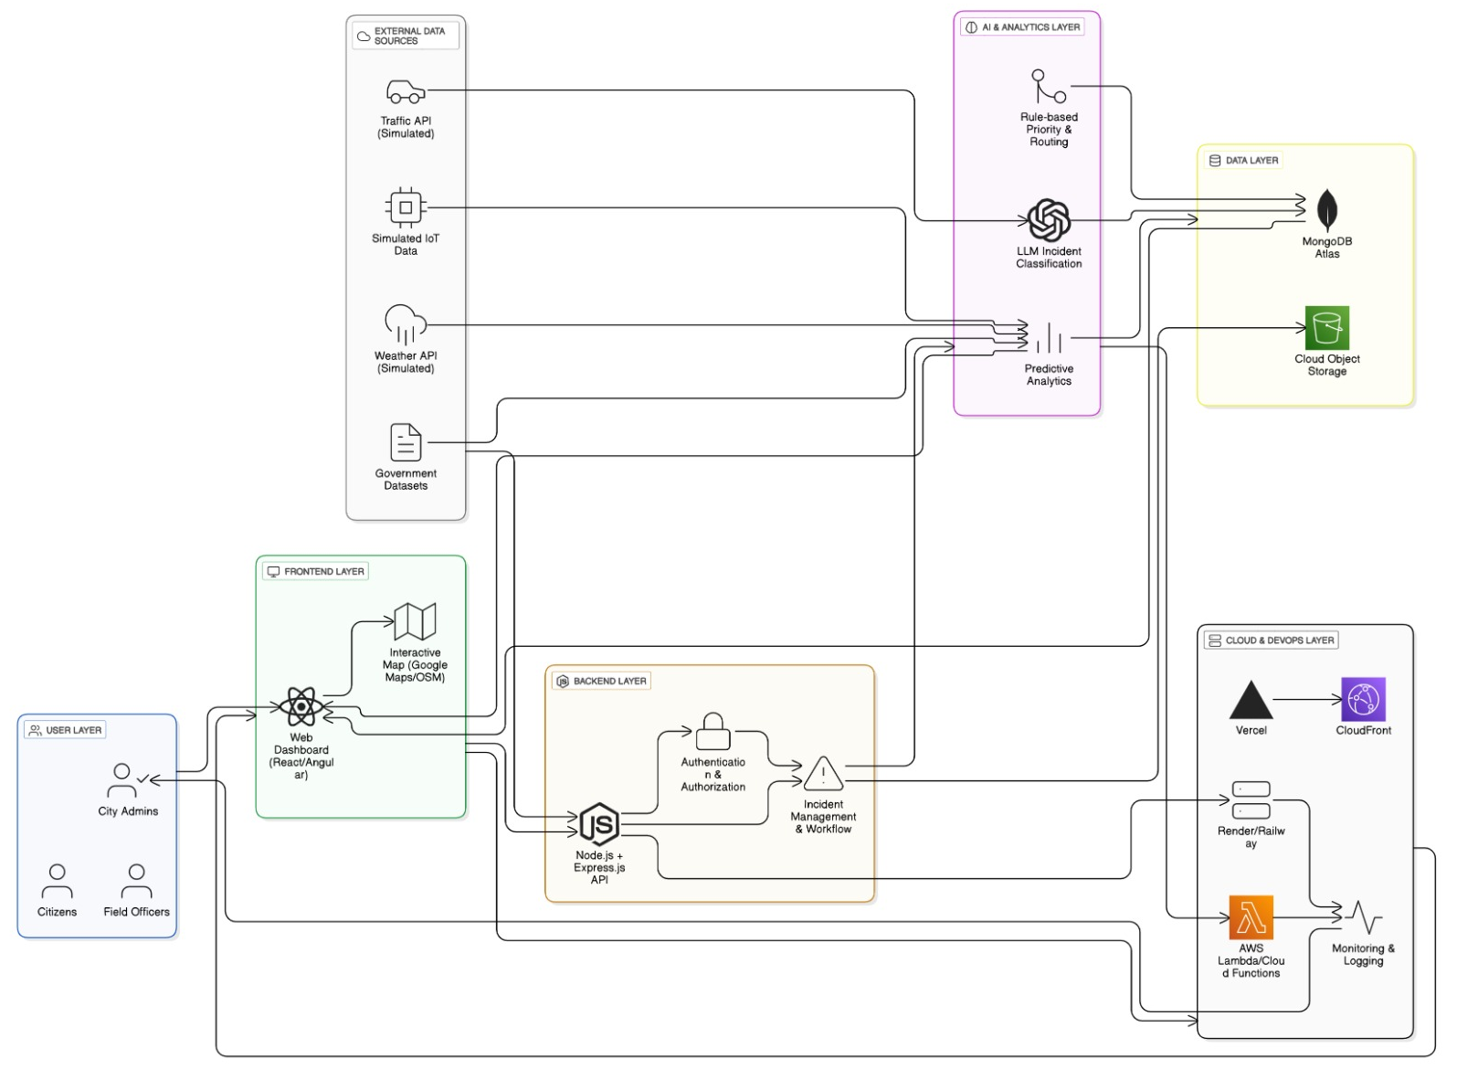
Architecture and System Flow

Slide 25
Workflow:
Input: City data is collected from multiple sources including traffic APIs, citizen complaints, sensor feeds,
and social media inputs.
Pre-Processing: Backend services clean, normalize, and validate incoming data to ensure consistency across departments.
AI Analysis: AI models classify incidents by type and severity, and prioritize them based on urgency and impact.
Decision & Routing:The system automatically assigns incidents to the appropriate city
departments with smart escalation rules.
Action: Field officers receive alerts, take action on-site, and update the resolution status through the system.
Result: City officials monitor real-time progress, response times, and analytics through the command dashboard,
ensuring transparency and efficient governance.

Slide 26
Functional Requirements
User registration and authentication
Submission of incidents and urban issues by users
Real-time data ingestion from multiple sources
Intelligent classification and prioritization of incidents
Automated routing of issues to relevant departments
Real-time dashboard for monitoring city-wide activities
Status tracking and resolution updates by field officers
Report generation and historical data analysis

Slide 27
Non-Functional Requirements
Scalability: Ability to handle increasing data volume and users
Performance: Low latency in data processing and dashboard updates
Availability: High system uptime and fault tolerance
Security: Secure authentication, authorization, and data privacy
Reliability: Consistent system behavior under load
Maintainability: Modular and extensible architecture
Usability: Intuitive and user-friendly interface

Slide 28
Expected Output
Command Dashboard (Officials View):
Live city dashboard displaying active incidents, severity levels, and department-wise status with color-coded alerts.
AI Incident Intelligence:
Automatically classified incidents with priority tags (High / Medium / Low).
AI-generated summaries providing clear, actionable insights for faster decision-making.
Department & Field Output:
Automated alert notifications sent to the appropriate departments and field officers.

Slide 29
DevOps Solution
GitHub Actions: Automated pipelines run unit tests, API tests, and build checks on every code commit. Failed builds prevent deployment, ensuring system stability and reliability.
CI/CD pipeline for automated build and deployment
Docker: Used to containerize backend services, AI modules, and frontend applications to ensure consistent deployment across development, testing, and production environments.
Automated testing before deployment to ensure stability
Continuous monitoring for application performance and errors

Slide 30
Cloud Integration (Planned)
Frontend Hosting: Vercel for scalable and fast UI delivery
Backend Hosting: Render / Railway for Node.js & Express APIs
Database: MongoDB Atlas
AI Services: AWS Lambda / Cloud Functions to run AI-based incident classification .
Storage: Cloud storage for logs and future document uploads
Delivery: CloudFront CDN for low-latency dashboard access and fast data visualization.

Slide 31
White papers / Research
Research Labs Referenced:
MIT Senseable City Lab: Research on data-driven urban planning and real-time city intelligence systems.
IBM Research – Smart Cities: Studies on AI-powered decision support and urban analytics platforms.
Relevant Papers:
“Smart City Data Integration and Analytics Framework” (IEEE Access, 2023).
“AI-Based Incident Detection and Response in Urban Environments” (ACM Digital Library, 2024).
“Can AI Teach Employability? A Multi-national Study” “Predictive Analytics for Traffic and Urban Risk Management” (Elsevier, 2023).the need for AI coaching.

Slide 32
Hackathon Referred
Google agentic Day AI hackathon
The Challenge
A city like Bengaluru generates massive real‑time data from traffic, civic issues, and social activity.
This data is noisy, scattered across platforms, and becomes outdated quickly.
The challenge is to extract meaningful signals and represent the live pulse of the city.
The Objective
Build an agentic AI application that provides a live, intelligent, and unified view of the city.
Transform scattered reports into clear, actionable insights for citizens and authorities.

Slide 33
Cost of the product
Built using open-source technologies (MERN stack), reducing development cost
Uses cloud-based services with free or student-tier plans during initial deployment
Major cost components:
AI & Analytics Costs: For AI model inference, LLM-based incident classification, and predictive analytics APIs.
Database storage (MongoDB Atlas)
Compute (Cloud VMs + Serverless): For hosting frontend, backend services, and AI microservices handling real-time city data and incident processing.
Overall product cost is cost-effective and scalable based on user growth
Significantly lower than traditional manual monitoring systems and scalable as city usage grows.

Slide 34
Our product is unique - Reasons
The “Intelligent Automation” Leap:
While traditional city dashboards are passive systems that only display data, our platform acts as an Intelligent Command Engine.
It automatically classifies incidents, prioritizes severity, and routes alerts to the correct departments instead of relying on manual coordination.
The “Closed-Loop Governance” Model:
The system uniquely connects incident detection → AI analysis → department action → resolution tracking → audit reporting in a single continuous loop.
City officials can go from incident identification to verified resolution with full transparency and minimal human intervention.

Slide 35
List of Modules with Explanation
1. Multi-Source Data Collection Module
Collects data from citizens, traffic APIs, social media, public platforms, and simulated IoT sources.
Ensures continuous and reliable city-wide data availability for analysis.
2. Data Preprocessing & Normalization Module
Cleans, validates, anonymizes, and standardizes incoming data.
Prepares structured and unstructured data for AI analysis and decision-making.
3. AI Incident Intelligence Module
Uses NLP and LLM-based models to understand issue type, location, and severity.
Automatically classifies, prioritizes, and summarizes city incidents.
4. Predictive Analytics & Risk Forecasting Module
Analyzes historical and real-time data to identify trends and predict future hotspots.
Supports proactive planning and early warning for city administrators.

Slide 36
List of Modules with Explanation
5. Automated Routing & Alert Module
Assigns incidents to the appropriate government departments using rule-based logic. Sends real-time alerts to officials, field officers, and nearby citizens.
6. Unified Command Dashboard Module
Provides a live dashboard with maps, alerts, analytics, and resolution tracking. Enables centralized monitoring, transparency, and faster decision-making.
7. Resolution Tracking & Audit Module
Tracks incident status from report to resolution. Maintains logs, response metrics, and audit records for governance evaluation.
8. User Interaction & Notification Module
Allows citizens to report issues and receive real-time updates. Improves public engagement and trust through transparent communication.

Slide 37
List of Reports with Purpose
Report Name | Purpose
Active Incidents Report | Displays all currently reported city incidents with status and severity.
Incident Type Distribution Report | Shows frequency of different issue types (traffic, potholes, accidents, etc.).
Severity & Priority Report | Highlights high-priority and critical incidents requiring immediate action.
Department Workload Report | Tracks number of incidents assigned to each government department.
Response Time Analysis Report | Measures average response and resolution time for incidents.
Incident Hotspot Report | Identifies geographical zones with high incident concentration.
Trend & Pattern Analysis Report | Shows historical trends and recurring urban problems over time.
Predictive Risk Forecast Report | Predicts potential future hotspots and risk-prone zones using AI models.
Citizen Complaint Status Report | Tracks complaint acknowledgment, progress, and resolution updates
Audit & Resolution Report | Maintains logs of actions taken, closures, and accountability tracking.

Slide 38
List of forms for the application
1. Incident Reporting Form
Allows citizens to report urban issues like potholes, accidents, or flooding with location and media evidence. This acts as the primary data entry point for the system.
2. Citizen Registration Form
Collects basic user details to enable complaint tracking and notifications. Ensures authenticated and reliable citizen participation.
3. Complaint Status Tracking Form
Enables citizens to track the progress of their reported incidents. Displays current status, assigned department, and resolution updates.
4. Incident Verification Form
Used by administrators to validate incidents detected by AI or citizens. Helps filter false reports and update severity levels.
5. Incident Assignment Form
Assigns verified incidents to the appropriate government department or field team. Ensures timely routing based on priority and location.
6. Resolution Update Form
Allows field officers to update action status and upload proof of resolution. Ensures transparency and accountability in issue handling.

Slide 39
7. Department Workload Form
Helps department heads monitor assigned incidents and staff workload. Supports efficient resource allocation and reassignment.
8. Report Generation Form
Used to generate analytical reports based on filters like time, location, and incident type. Supports data-driven decision making.
9. Hotspot Analysis Form
Configures inputs to identify areas with high incident concentration. Helps authorities focus on high-risk zones.
10. Predictive Risk Configuration Form
Defines parameters for AI-based future risk prediction. Supports proactive urban planning and prevention.
11. Alert Configuration Form
Sets rules for sending alerts to officials and citizens. Ensures timely communication during critical situations.
12. Feedback & Rating Form
Allows citizens to provide feedback after issue resolution. Helps measure service quality and improve governance.

Slide 40
List of Tables for the application
Table 1: Multi-Source Data Acquisition Module Specification Describes the data sources, ingestion mechanisms, and inputs used to collect city-wide information.
Table 2: Data Preprocessing and Normalization Module Specification Details the data cleaning, validation, anonymization, and standardization processes.
Table 3: AI-Based Incident Intelligence Module Specification Explains the AI techniques used for incident classification, prioritization, and summarization.
Table 4: Predictive Analytics and Risk Forecasting Module Specification Presents methods used to analyze trends and predict future incident hotspots.
Table 5: Automated Incident Routing and Alert Management Module Specification Describes the logic used to assign incidents to departments and generate real-time alerts.
Table 6: Unified Command and Monitoring Dashboard Module Specification Outlines the dashboard features, visualizations, and real-time monitoring capabilities.
Table 7: Incident Resolution Tracking and Audit Management Module Specification Details how incident status, response metrics, and audit logs are maintained.
Table 8: User Interaction and Notification Management Module Specification Explains user engagement features and notification mechanisms for transparency and communication.

